Slide 1
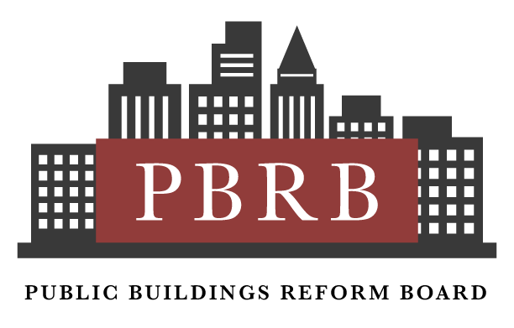
Public Meeting January 28, 2025

Slide 2
Program- Public Buildings Reform Board Public Meeting
Public Buildings Reform Board introduction and presentation on Board work nationwide
Public Buildings Reform Board presentation on Opportunities for Changing the Federal City:
Mr. Talmage Hocker, Acting Chairman, PBRB presentation on analysis of potential opportunities for Changing the Federal City
Mr. Michael Peters, Public Buildings Service Commissioner, GSA
Mr. Marcel Acosta, Executive Director, National Capital Planning Commission
Mr. Joseph Ruocco, Principal, SOM (Skidmore, Owings and Merrill) presentation on A New Vision for Our Nation’s Capital
Ms. Nina Albert, Deputy Mayor, Office of the Deputy Mayor for Planning and Economic Development, Washington D.C.
Mr. Anthony Williams, CEO and Executive Director, Federal City Council
Public Comments and remarks
Concluding remarks from the Public Buildings Reform Board

Slide 3
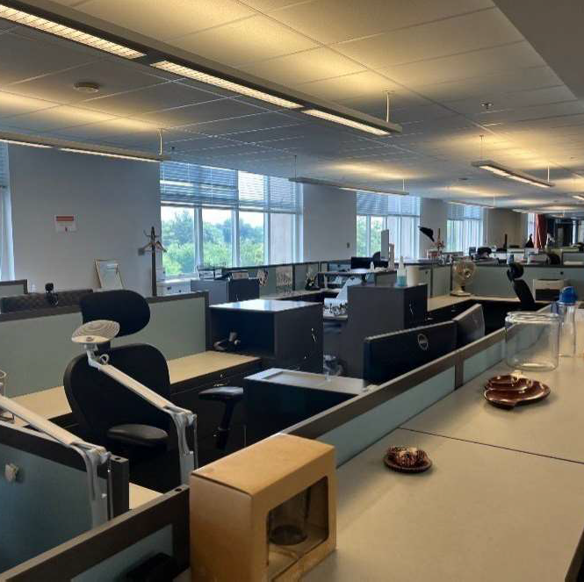
Congress authorized the Public Buildings Reform Board to make recommendations
The Public Buildings Reform Board (PBRB or Board) was created by the Federal Assets Sale Transfer Act (FASTA) to provide expertise and recommendations to the Federal government and Congress on how to reduce the costs of the federal real property portfolio, while giving back to local communities, making appreciable gains in energy and carbon emission goals, sending sales proceeds back to the Treasury while also providing agencies and their employees with modern, updated workspaces.
The PBRB, in its first two reports, recommended the sale of approximately $775 million in proceeds of federal real property. The next set of PBRB recommendations would produce approximately $19 billion in additional cost savings and likely more than $1.8 billion in proceeds if approved. And there are more opportunities to be identified.

Slide 4
The Board’s independent analysis has found that:
American taxpayers pay a premium for space, but those spaces are not premium spaces. Federal buildings are aging and in dire need of investment and repair.
Capital liabilities accruing to the American taxpayer for deferred maintenance is likely to be more than $72 billion across the GSA’s portfolio, and no agency has a handle on what the actual liabilities are.
The backlog of maintenance translates into unhealthy and sometimes unsafe work environments for Federal employees. Leaking roofs and windows, aging HVAC and air exchanger systems, inoperable elevators and outdated fire and life safety systems are common issues. Legionella and poor water quality has become a new reality.
The cost per person for this poorly maintained office space is skyrocketing. Fewer workers are using increasingly expensive properties. The PBRB found a nearly 70% decrease in occupancy in a study of selected properties in Washington D.C. in 2023.
Congress cannot appropriate its way out of this deficit. The Board believes that GSA and the federal agencies should be doing more to divest from properties that need significant maintenance as a measure to reduce the liabilities.
Agencies are reluctant to take action, lack resources and political will, and until this month, GSA has lacked authority to make agencies consolidate. Recent legislation has provided GSA with authority to enact consolidations.
The Problem: Vast oversupply of poorly maintained office space with few Federal users

Slide 5
Problem solving tools are provided by FASTA
FASTA and the PBRB provide agencies with tools that solve historic problems that have stymied dispositions:
FASTA established a fund, the Asset Proceeds and Space Management Fund for the purpose of supporting dispositions. The fund receives money from the sale of federal properties, and GSA has the authority to seek authorizations and spend those funds in preparation for further consolidations and dispositions under FASTA.
Agencies can retain funds from property sales. Under amendments to the law, agencies divesting from their properties will retain the receipts from the sales. FASTA establishes that the net proceeds from a disposition (proceeds from a property sale minus the costs for the sale) are retained by the agency owning the property at the time it is declared excess.
FASTA provides the GSA Administrator with increased discretion regarding transactions. FASTA allows the GSA Administrator exemption from the normal stipulations, allowing the Administrator the ability to enter into a real property conveyance for less than fair market value, for no consideration at all, or into a transaction that mandates the exclusion of other market participants.

Slide 6
Legislation signed into law January 2025 provides a mandate for reforms
On January 4, 2025, President Biden signed into law a bill that extends the PBRB until December 2026. Other provisions of the law:
The Office of Management and Budget (OMB) will identify methodologies for counting the number of employees using a Federal building at least 40 hours a week over a two-month period. Occupancy data will be reported to the House and Senate oversight committees.
Agencies will make occupancy data public on a General Services Administration (GSA) website.
One year after enactment, OMB and GSA will ensure buildings are used 60% on average over each 1-year period, and if occupancy is below 60%, the tenant agency shall be notified along with Congressional oversight committees.
After the first year of enactment, if agency fails to meet 60% target, GSA will take steps to reduce the space of tenant agencies.
Capital investments made by GSA shall be in buildings where occupancy is 60% or more.
One year after enactment, OMB and GSA will submit a plan to the oversight committees and the GAO a plan to consolidate headquarter buildings within the National Capital Region to bring occupancy to 60% or greater.
  This plan shall be implemented one year after it has been submitted.

Slide 7
Site | City
Sam Nunn | Atlanta, GA
John W. McCormack | Boston, MA
Thomas P. O'Neill Jr. | Boston, MA
Claude Pepper | Miami, FL
New LA FBI Site | Los Angeles, CA
New VA State Lease | Los Angeles, CA
4000 Masthead | Albuquerque, NM
JFK Federal | Boston, MA
CPT JF Williams | Boston, MA
Lipinski Building | Chicago, IL
Martin Luther King JR Federal Building | Atlanta, GA
Peachtree Summit | Atlanta, GA
IRS Service Center | Atlanta, GA
IRS Annex | Atlanta, GA
Brickell Building | Miami, FL
3900 Masthead | Albuquerque, NM
R3 Forestry ServiceRegional Office | Albuquerque, NM
Wilshire Federal Building | Los Angeles, CA
San Antonio Federal Building | San Antonio, TX
LaBranch Federal Building | Houston, TX
Huntsville US Courthouse and Post Office | Huntsville, AB
Joel W. Solomon Federal Building | Chattanooga, TN
Estes Kefauver Courthouse and Annex | Nashville, TN
Ft. Lauderdale Post Office and Courthouse | Ft. Lauderdale, FL
8300 Ward Parkway | Kansas City, MO
SEC Regional (33 Arch) | Boston, MA
Sites being considered by the PBRB outside the Washington D.C. metropolitan area: both consolidations and disposals

Slide 8

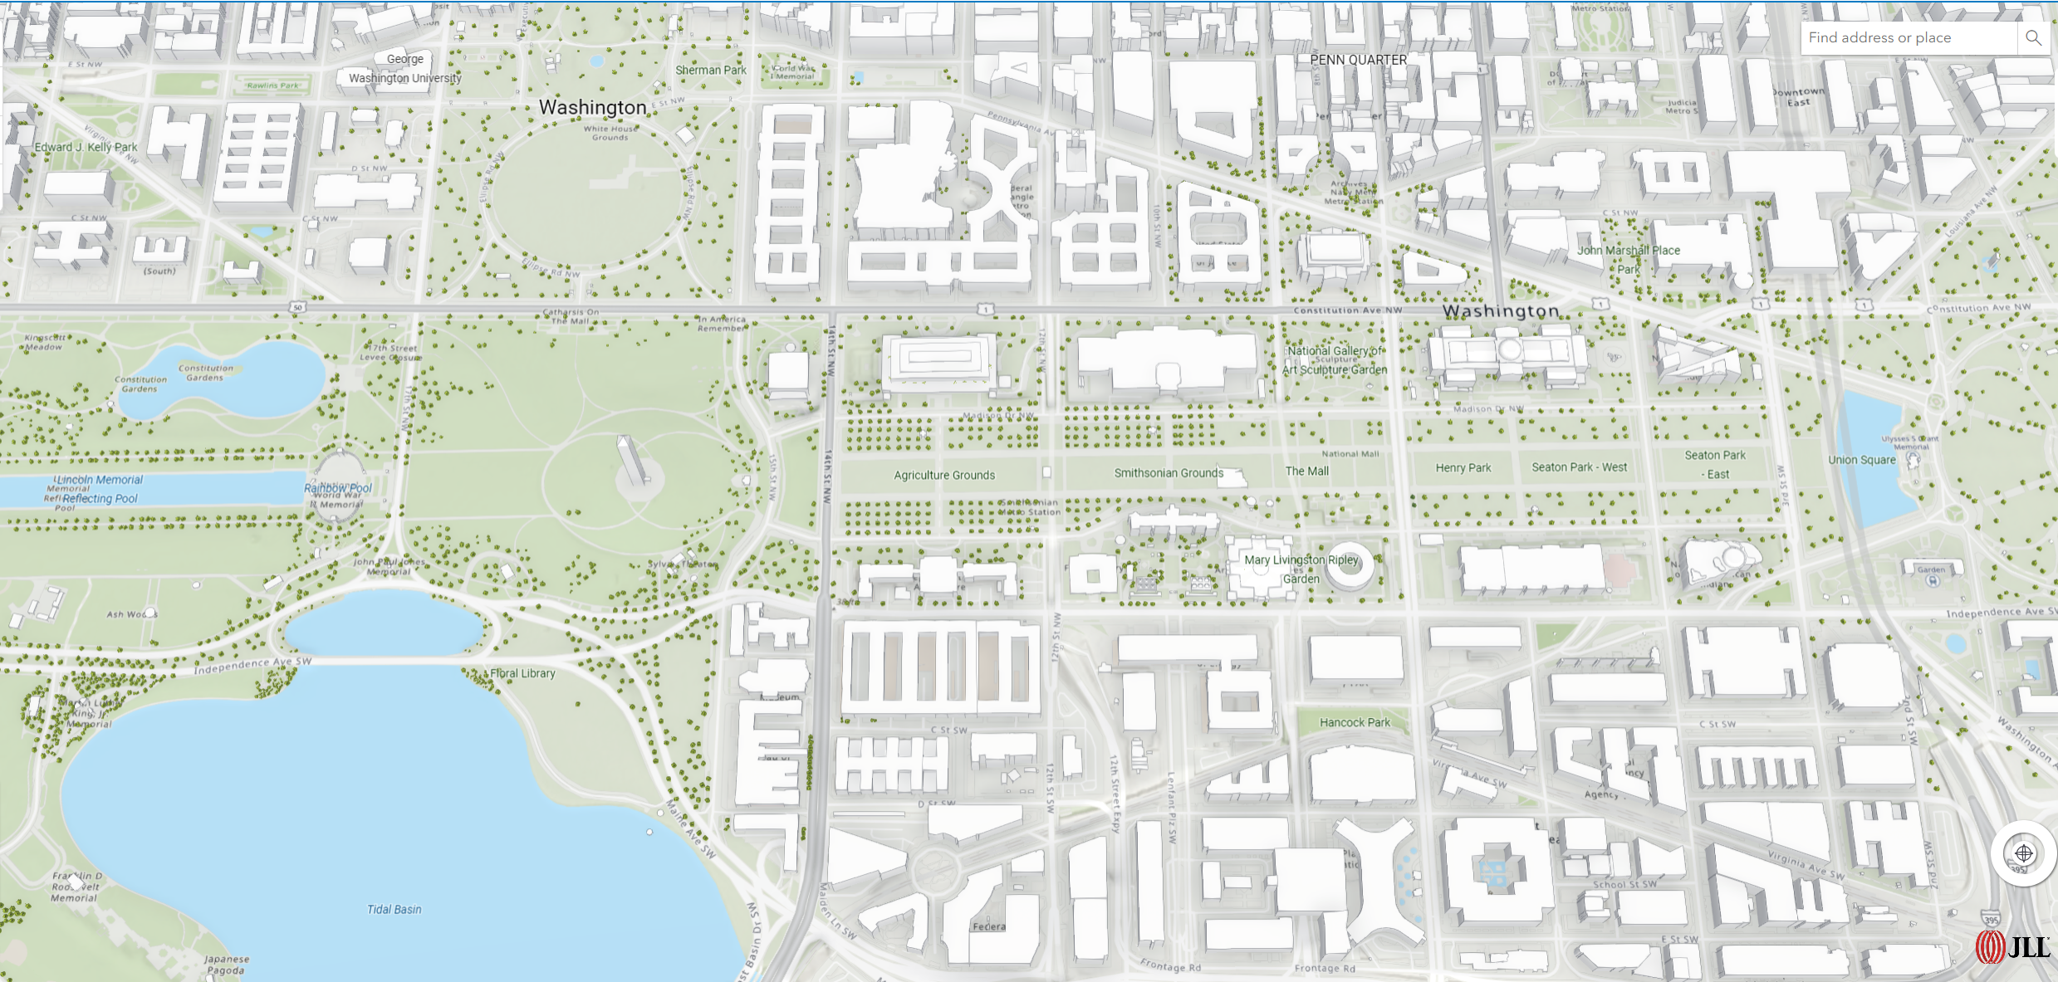
PBRB Evaluation of Federal Buildings in the National Capital Region
1800 F
Street
Opportunity Properties
& Areas (Consolidation or Disposition)
Nebraska Ave
Complex
Federal Triangle- potential receiver sites
Phasing to be determined
Roosevelt
Building
Perkins Building
Federal Opportunities South of Independence
Yates
Building
Orville
Wright
Building
Wilbur
Wright
Building
Cohen
Building
Humphrey
Building
Ag South
Forrestal Complex
Liberty Loan
Former GSA Regional Bldg 7th and D
Bureau of Engraving & Printing
Forrestal – potential catalyst
Mary Switzer Building
Southwest – potential mixed use
Robert Weaver Building

Slide 9
Site | City
George Washington Carver Campus | Beltsville, MD
Department of Transportation | Washington DC
Stewart Lee Udall Federal Building | Washington DC
Ronald Reagan Building | Washington DC
New Carrollton Federal Building | New Carrollton, MD
Wilbur Wright | Washington DC
Orville Wright Building | Washington DC
Agriculture South Bldg. & Whitten | Washington DC
Mary E. Switzer | Washington DC
Nebraska Ave Complex | Washington DC
River Road-APHIS | Riverdale, MD
Braddock Place | Alexandria, VA
Sidney Yates | Washington DC
Robert C. Weaver | Washington DC
James V Forrestal Complex | Washington DC
Theodore Roosevelt | Washington DC
Bureau of Engraving and Printing Annex | Washington DC
GSA HQ | Washington DC
IRS | Washington DC
Wilbur J. Cohen Building | Washington DC
Hubert Humphrey Building | Washington DC
Herbert C. Hoover Building (DoC) | Washington DC
Frances Perkins | Washington DC
Liberty Loan | Washington DC
Sites being considered by the PBRB in the Washington D.C. metropolitan area for consolidation or disposition:

